Slide 1

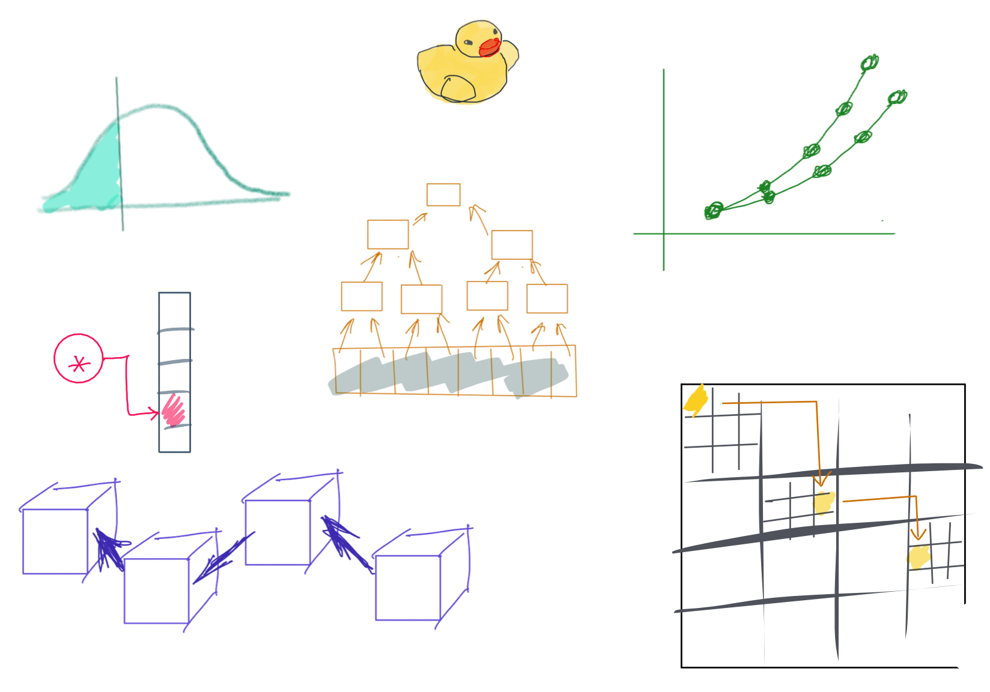

Slide 2
CSS342 Data Structures, Algorithms, and Discrete Mathematics (I)

Slide 3
Where are we at now?
ADT (array vs list)
One-dimensional ADT
ArrayList
Stack
LinkedList
Queue
Hash table
Recursion
Search Problem
Sorting
Binary tree
multi-dimensional ADT

Slide 4
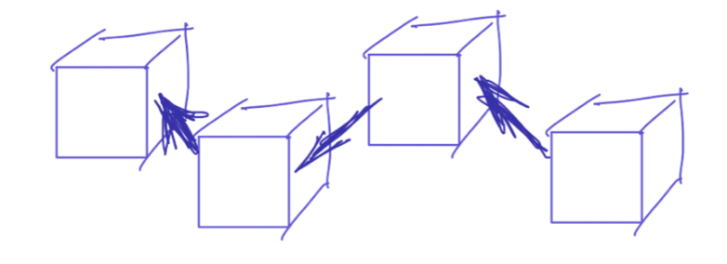
^{5th} Week Schedule
Homework 2 Review (Wed)
ADT List (single linked list) (Wed)
ADT Queue and Stack (Fri)
Quiz-2 (Thur, 4/28). See Discord #quiz-2 for details.
Homework 3 to be assigned on Fri around noon

Slide 5

Homework 2 Review

Slide 6



The Formula
Monthly deposit
$$×$$
12
+
Initial Deposit
Annual deposit
$$×$$
annual increase rate
Yearly deposit

Slide 7
Compounding Interest
Year 0
Year 1
Initial value
rate %
Initial deposit for year 0
annual contribution

Slide 8
Compounding Interest
Year 0
Year 1
Year 2
Initial value
rate %
annual contribution

Slide 9
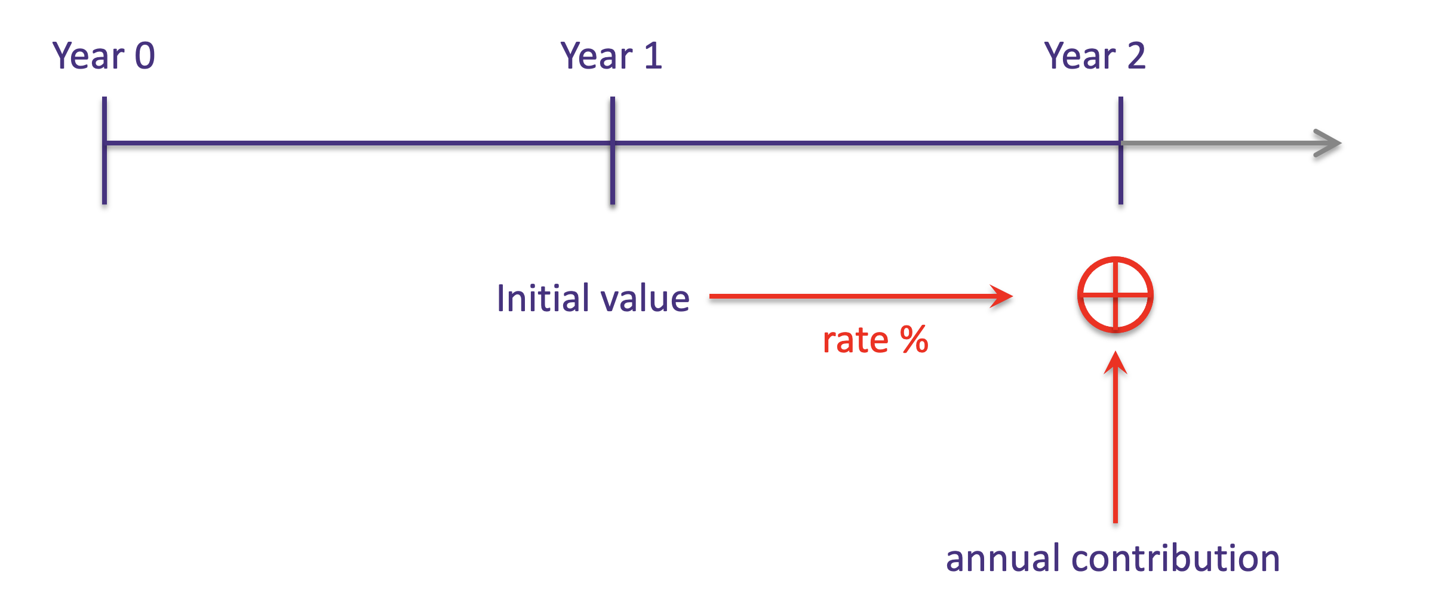
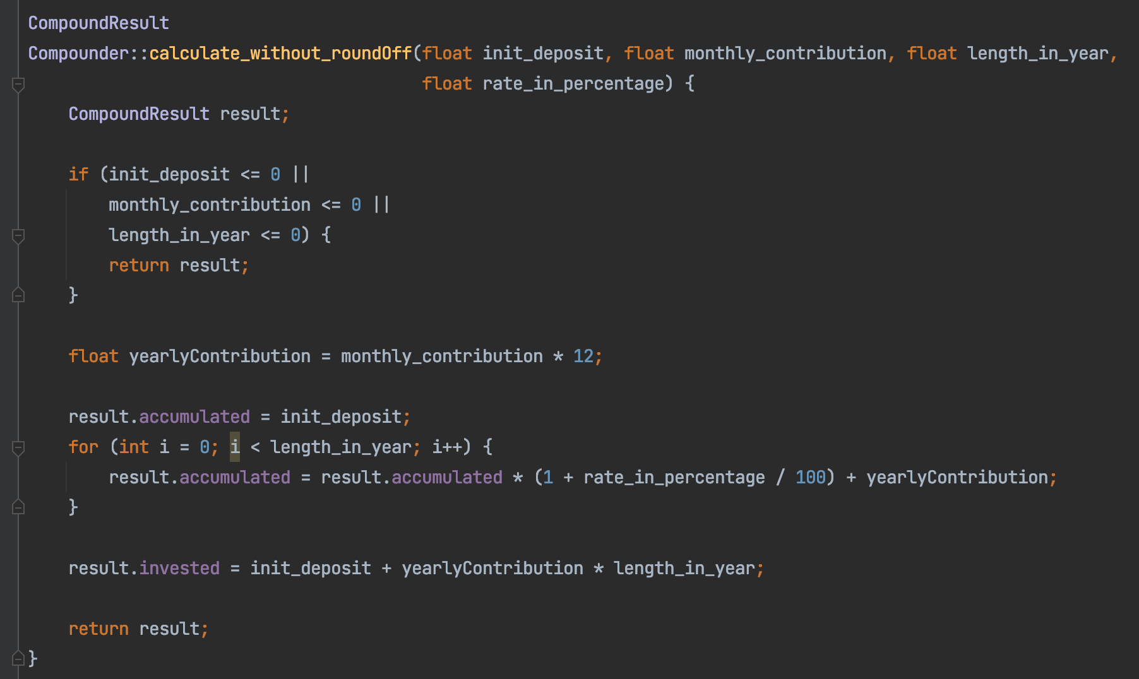

Slide 10
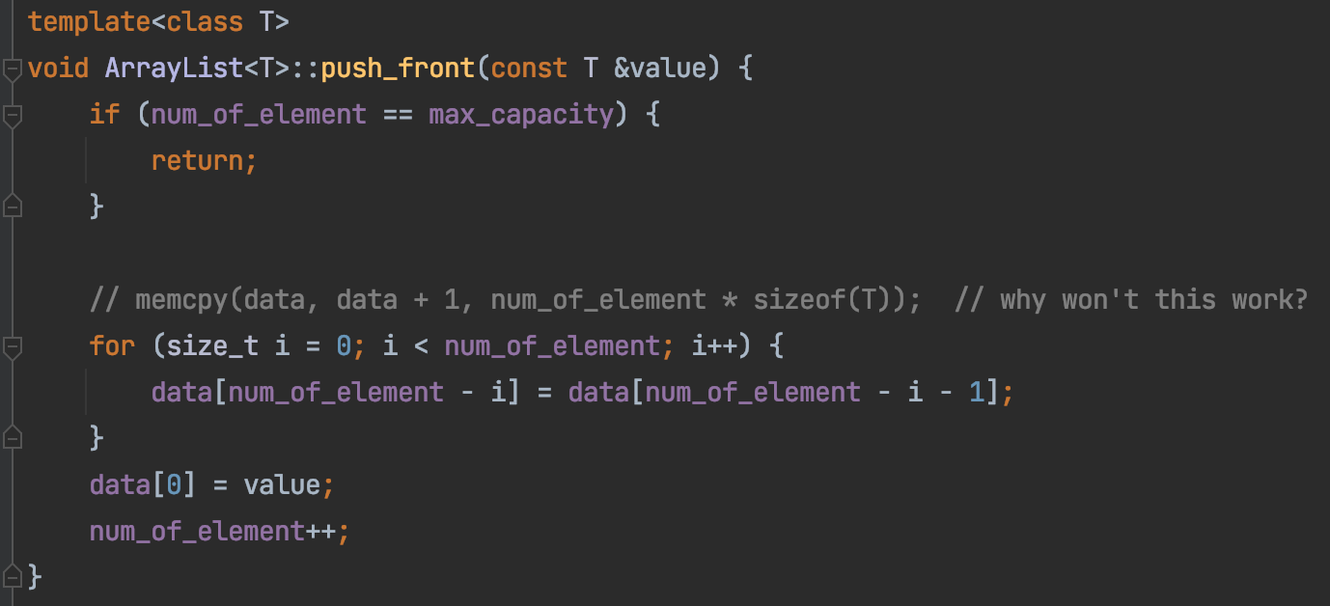
List & ArrayList
push_front
20
8
3
35

Slide 11
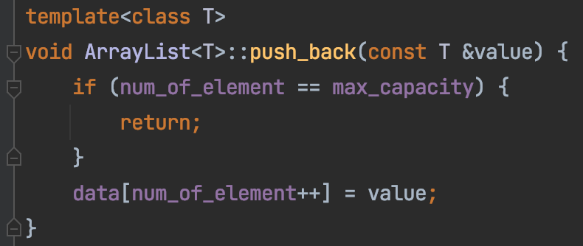
List & ArrayList
push_back
20
8
3
35

Slide 12
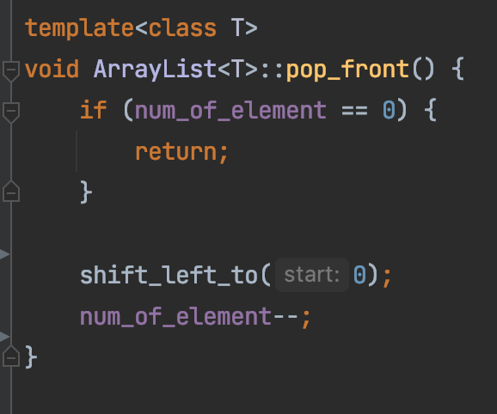
List & ArrayList
pop_front
20
8
3
35

Slide 13
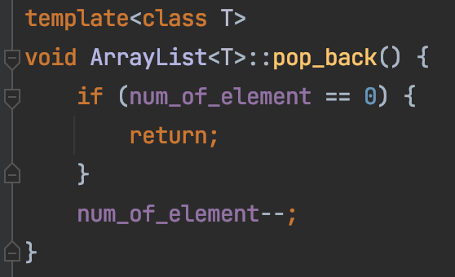
List & ArrayList
pop_back
20
8
3
35

Slide 14
List & ArrayList
2
8
9
12
33
-1
4
13
merge
-1
2
4
8
9
12
13
33
Code here

Slide 15
Design a system to store a set of user id
User id: 8, 35, 20, 7
Assumption:
Integer to store user id
Requirement:
Fast search
Fast insertion/deletion
Binary Search
Bubble Sort
ArrayList

Slide 16
Design a system to store a set of user id
User id: 8, 35, 20, 7
7
8
20
35

Slide 17
Design a system to store a set of user id
User id: 8, 35, 20, 7
7
8
20
35
Insert 13 here

Slide 18
Design a system to store a set of user id
User id: 8, 35, 20, 7
7
8
13
20
35
What if array has 1 million user ids and we are constantly inserting to the front

Slide 19


Array vs List
12
12
1
7
18
10
3
Array index
0
1
2
3
4
5
6
Memory address (Hexadecimal)
0x00
0x04
0x08
0x0C
0x10
0x14
0x18

Slide 20
Design a system to store a set of user id
7
8
20
35
Insert 13 here
Problem:
memory copy is very SLOW
Visit too many elements

Slide 21
Array → List
12
12
1
7
18
10
3
head
12
12
12
1
7
18
10
3
null
value
“Node”
reference

Slide 22
Single Linked List
Head (Dummy node)
[1,4,2]
12
1
4
2
null
value
“Node”
reference

Slide 23
12
1
7
3

Slide 24
Memory Layout
list
array
Memory space

Slide 25
Memory Layout
addr0
12
addr1
addr8
addr2
addr3
addr4
7
addr0
addr5
addr10
addr1
12
addr6
head
addr2
12
addr0
addr7
addr3
12
1
addr8
addr4
1
addr4
addr9
addr5
7
18
addr10
addr6
18
addr11
addr14
addr7
10
addr12
3
addr8
3
addr13
null
addr9
addr14
10
addr10
addr15
addr12
array
list
addr16

Slide 26
Array vs List
Array:
Contiguous in memory
Fast random access
Fixed size
12
12
1
7
18
10
3
head
12
12
1
7
18
10
3
null
LinkedList:
Random addressed in memory
No random access
Size not fixed
More comparison between array and linked list

Slide 27
Single Linked List vs Double Linked List
head
12
12
1
7
18
10
3
Single/Singly Linked List
null
head
12
12
1
7
18
10
3
null
null
Double/Doubly Linked List

Slide 28
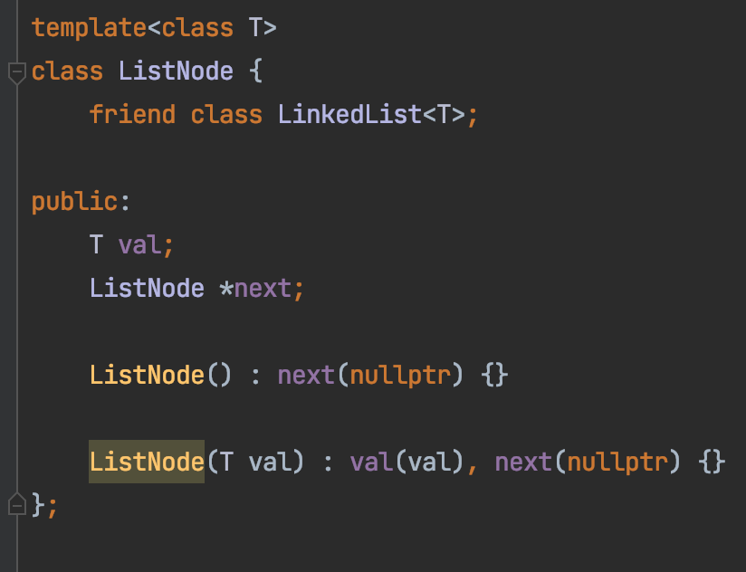
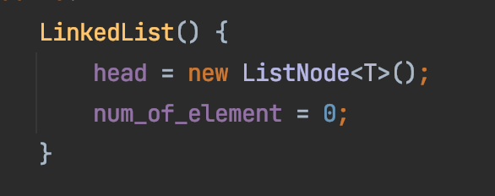
Functions to study:
head
null
null

Slide 29
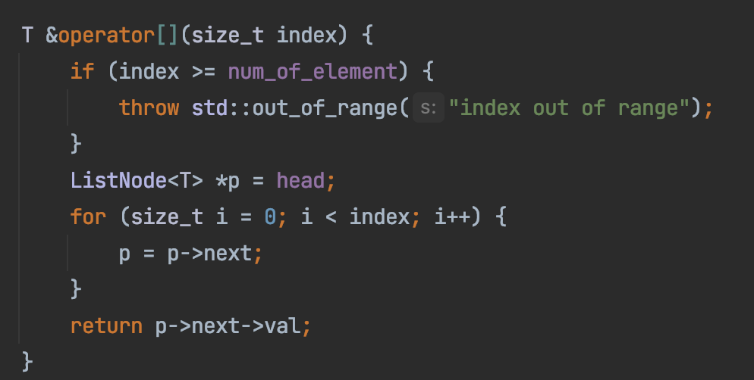
Functions to study:
head
null

Slide 30
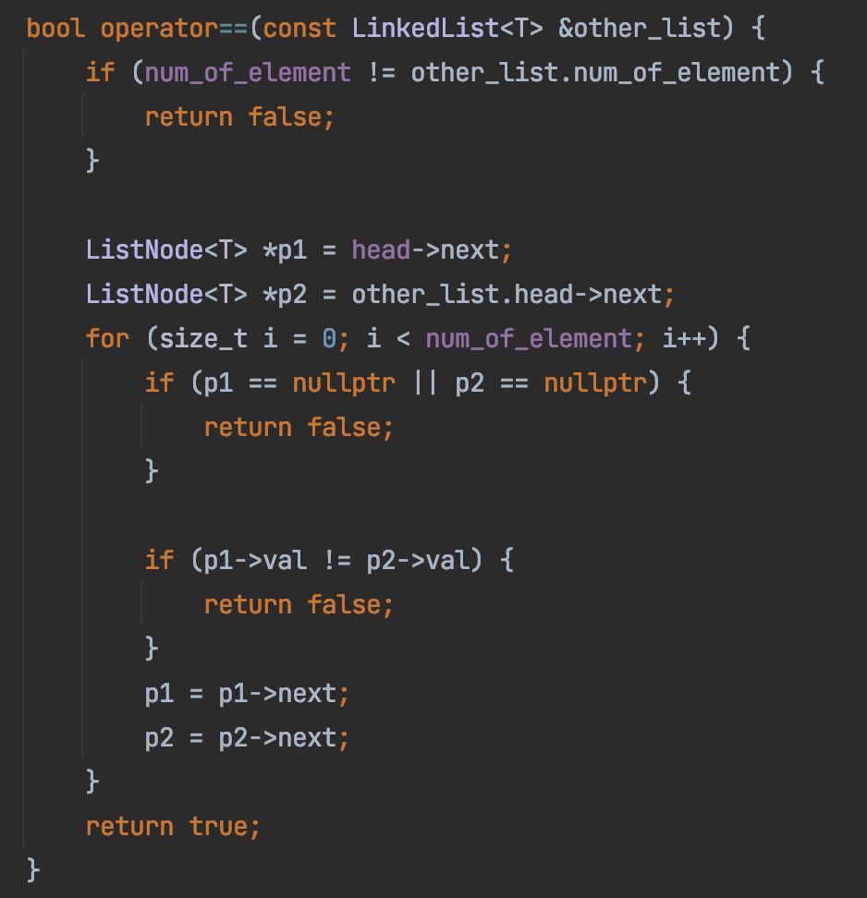
Functions to study:
head
null
head
null

Slide 31
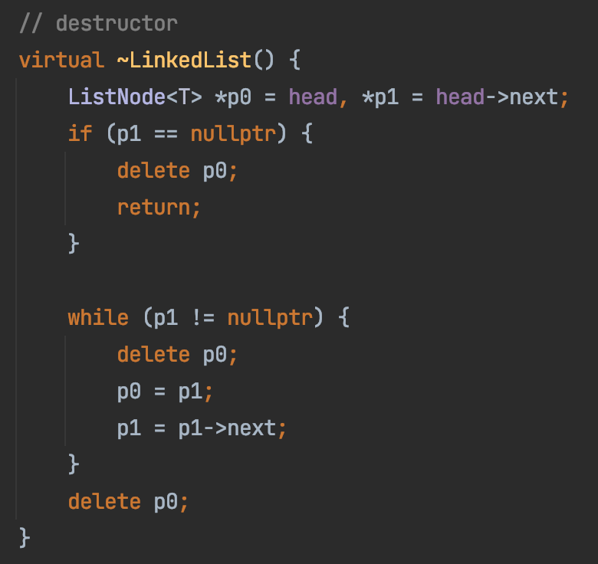
Functions to study:
head
null

Slide 32
Performance Validation
add(0, val)
Linear time
head
null
add(0, val)
Constant time

Slide 33
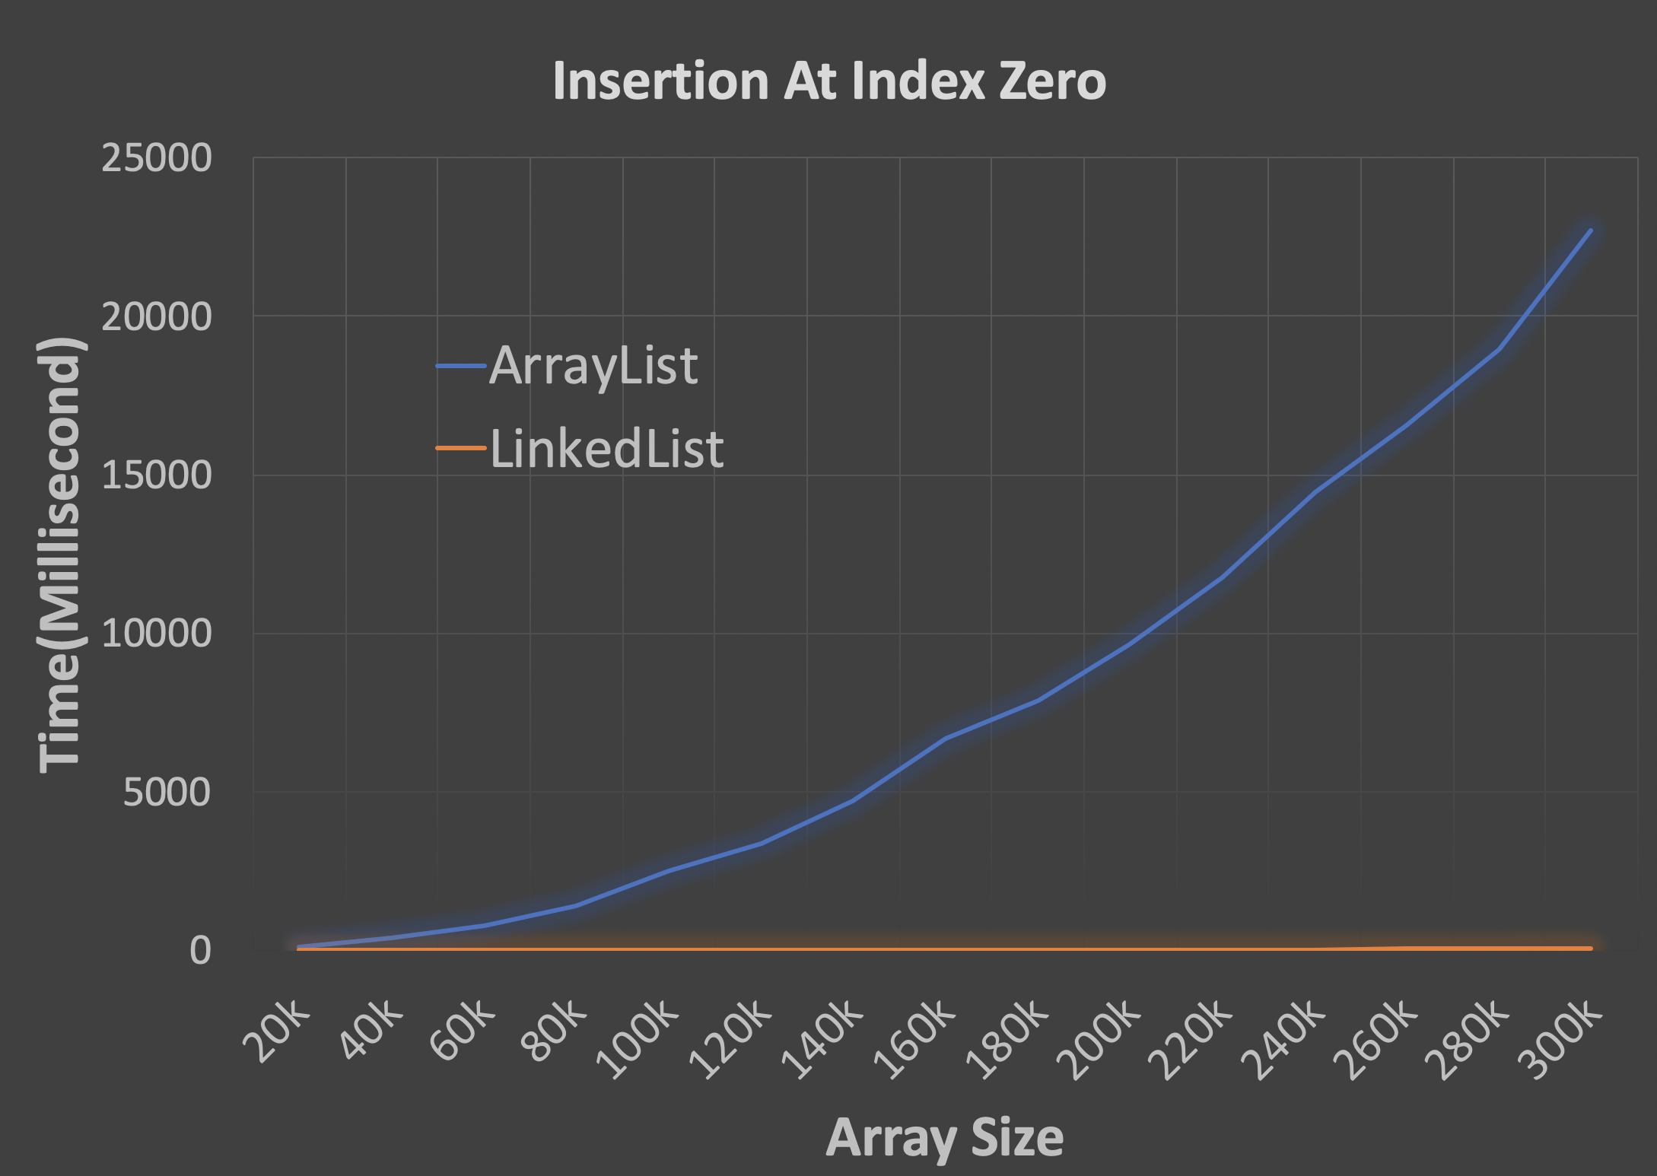
Performance Validation

Slide 34

Practice
Print out the values of a single linked list
Front to back: 1, 4, 2
Back to front: 2, 4 1
12
1
4
2
null
Code here

Slide 35

ADT: Queue
First In First Out (FIFO)

Slide 36
Queue ADT
poll()
12
12
12
1
7
18
10
3
12
1
7
18
10
3
add(…)

Slide 37
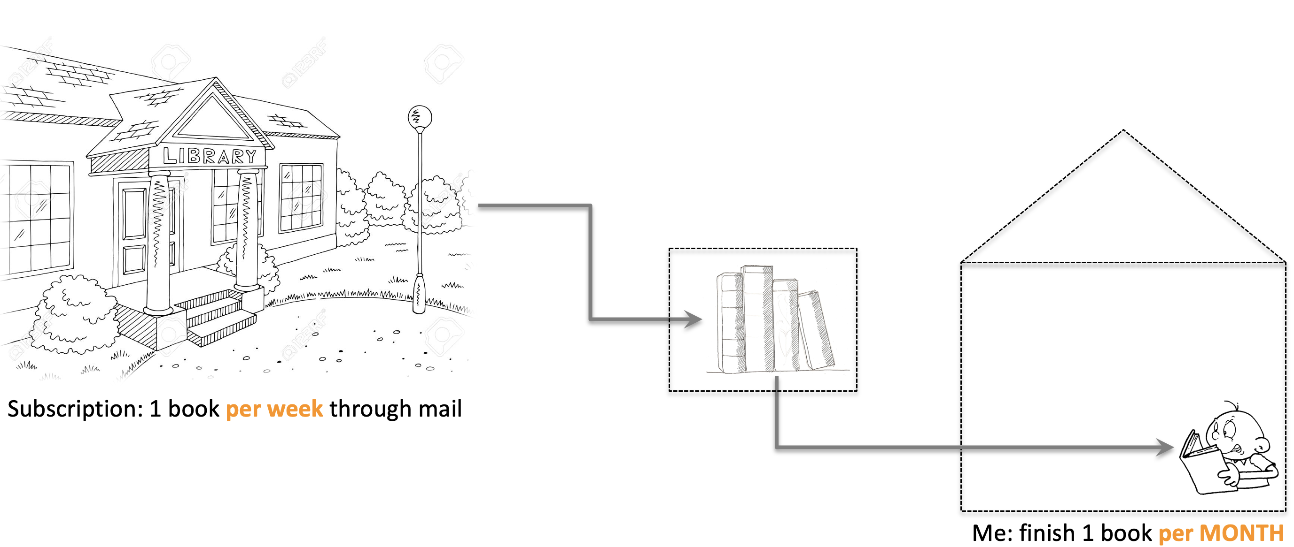
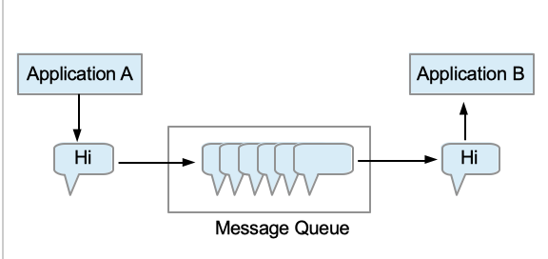
Applications
Queue
allows working at different speeds

Slide 38
Stack ADT
push(…)
12
12
12
1
7
18
10
3
12
1
7
18
10
3
pop()

Slide 39
ADT: Stack
First In Last Out (FILO)

Slide 40
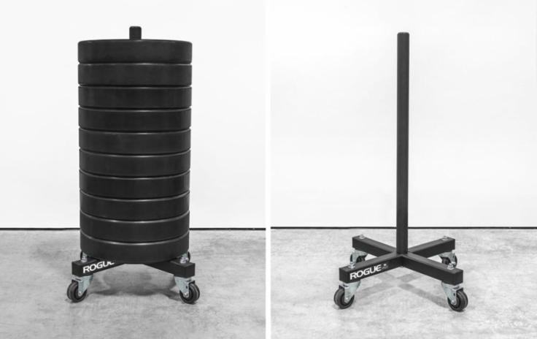
Stack ADT
push(…)
pop()
push(…)
pop()
First In Last Out (FILO)

Slide 41
Stack ADT
push(…)
12
12
12
1
7
18
10
3
12
1
7
18
10
3
pop()

